Slide 1
Sericulture- a brief Introduction
By
Dr. Tahir Hussain Shah
Lecturer, Department of Zoology
Govt. Post Graduate College
Rajouri

Slide 2


Sericulture
Sericulture, or silk farming, is the rearing of silkworms for the production of silk.
There are several commercial species of silkworms, Bombyx mori is the most widely used and intensively studied
Silk is a natural protein fibre, some forms of which can be woven into textiles. The protein fibre of silk is composed mainly of fibroin and produced by certain insect larvae to form cocoons

Slide 3
Why Sericulture
It is versatile and very comfortable.
It absorbs moisture.
It is cool to wear in the summer yet warm to wear in winter.
It can be easily dyed.
It retains its shape and is relatively smooth.
It has a poor resistance to sunlight exposure.
It is the strongest natural fiber and is lustrous

Slide 4
Type of silkworm
There are five major types of silk of commercial importance, obtained from different species of silkworms which in turn feed on a number of food plants
Except mulberry, other varieties of silks are generally termed as non-mulberry silks. India has the unique distinction of producing all these commercial varieties of silk

Slide 5
Mulberry
The bulk of the commercial silk produced in the world comes from this variety and often silk generally refers to mulberry silk
Mulberry silk comes from the silkworm, Bombyx mori L. which solely feeds on the leaves of mulberry plant( Mulberry sp. Morus alba, M. indica)
In India, the major mulberry silk producing states are Karnataka, Andhra Pradesh, West Bengal, Tamil Nadu and Jammu & Kashmir which together accounts for 92 % of country's total mulberry raw silk production

Slide 6
Tasar
Tasar (Tussah) is copper in colour, coarse silk mainly used for furnishings and interiors.
Tasar silk is generated by the silkworm, Antheraea mylitta, which mainly thrive on the food plants Asan and Arjun (Terminalia tomentosa, T. arjuna)
In India, Tasar silk is mainly produced in the states of Jharkhand, Chhattisgarh and Orissa, besides Maharashtra, West Bengal and Andhra Pradesh.

Slide 7
Oak Tasar
It is a finer variety of tasar generated by the silkworm, Antheraea proyeli J. in India which feed on natural food plants of oak, (Quercus serrata, Q. incana) found in abundance in the sub-Himalayan belt of India covering the states of Manipur, Himachal Pradesh, Uttar Pradesh, Assam, Meghalaya and Jammu & Kashmir
China is the major producer of oak tasar in the world and this comes from another silkworm which is known as Antheraea pernyi

Slide 8
Eri
Also known as Endi or Errandi, Eri is a multivoltine silk spun from open-ended cocoons, unlike other varieties of silk
Eri silk is the product of the domesticated silkworm, Philosamia ricini , Attacus ricini that feeds mainly on castor leaves ( Ricinus communis)
The silk is used indigenously for preparation of chaddars (wraps) for own use by these tribals. In India, this culture is practiced mainly in the north-eastern states and Assam. It is also found in Bihar, West Bengal and Orissa

Slide 9
Muga
This golden yellow colour silk is prerogative of India and the pride of Assam state. It is obtained from semi-domesticated multivoltine silkworm, Antheraea assamensis
These silkworms feed on the aromatic leaves of Som ( Machilus sp.) and Soalu ( Litsea sp.) plants
Muga culture is specific to the state of Assam and an integral part of the tradition and culture of that state. The muga silk, an high value product is used in products like sarees, mekhalas, chaddars, etc.

Slide 10
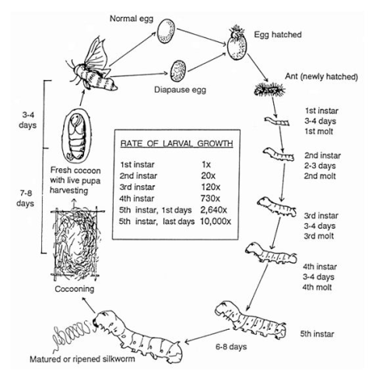
Life cycle of Silkworm

Slide 11
